Slide 1

Department of ICT
B.E Sem : II (CE/IT/AI) (MU)
Subject Name: MAVC
Unit no:- 4
Unit title:
Vector Integral calculus
Subject name : MAVC
Code:01MA1151

Slide 2
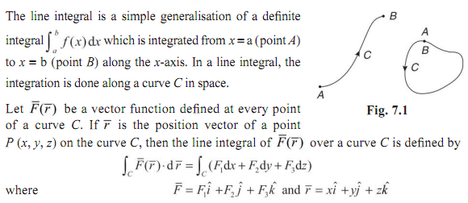
Line integrals

Slide 3
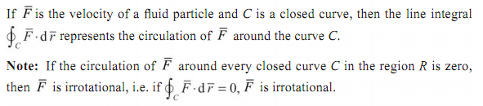

Line integrals
Circulation
Work done by a Force

Slide 4
Line integrals

Slide 5
Line integrals

Slide 6
Line integrals

Slide 7

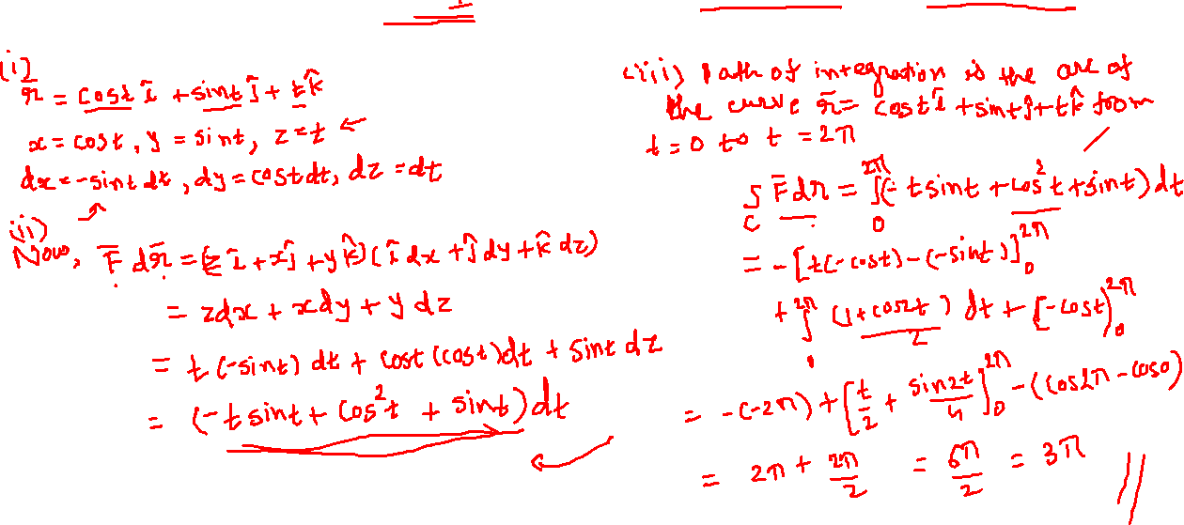
Line integrals

Slide 8

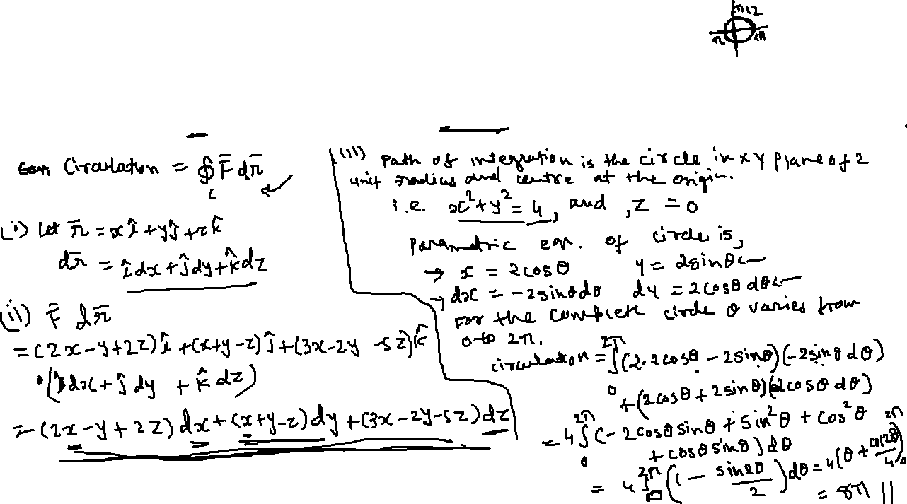
Line integrals

Slide 9


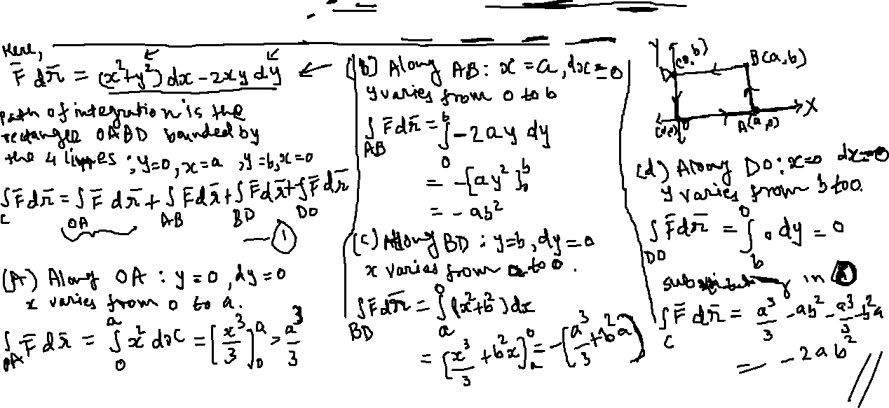
Line integrals

Slide 10

Line integrals

Slide 11
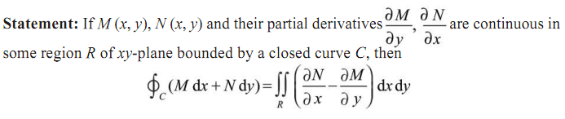




Green’s theorem

Slide 12



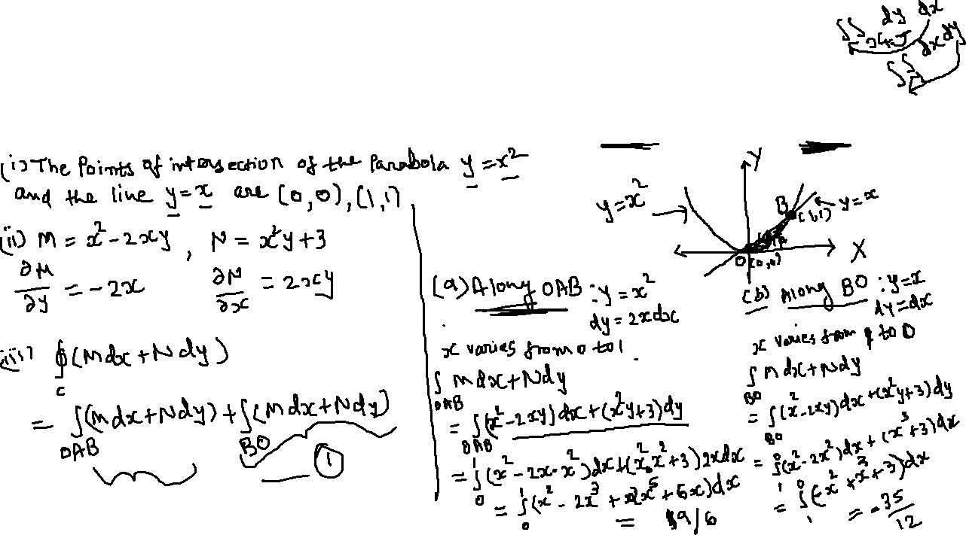

Green’s theorem

Slide 13
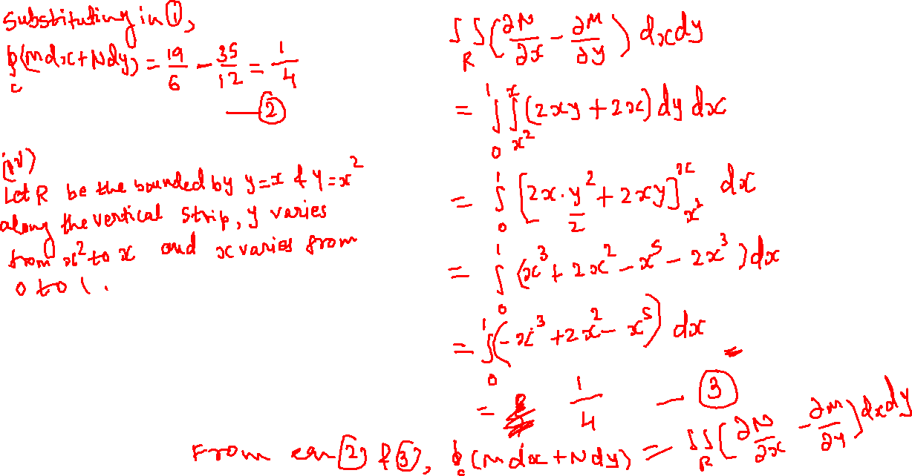
Green’s theorem

Slide 14
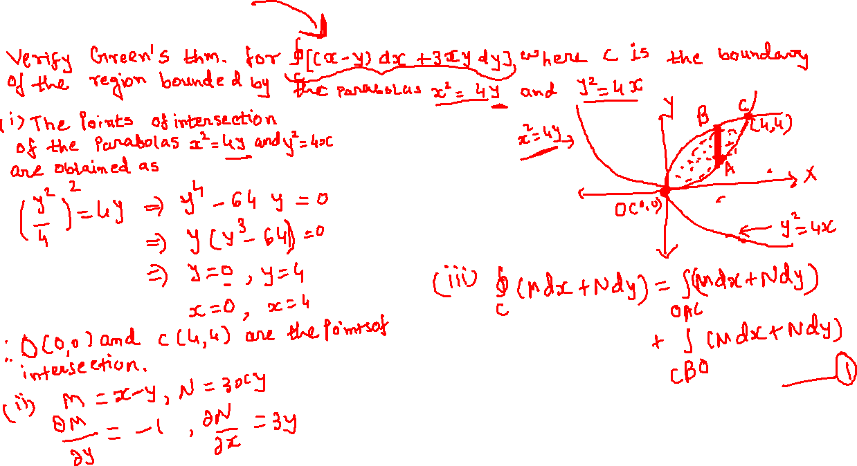
Green’s theorem

Slide 15
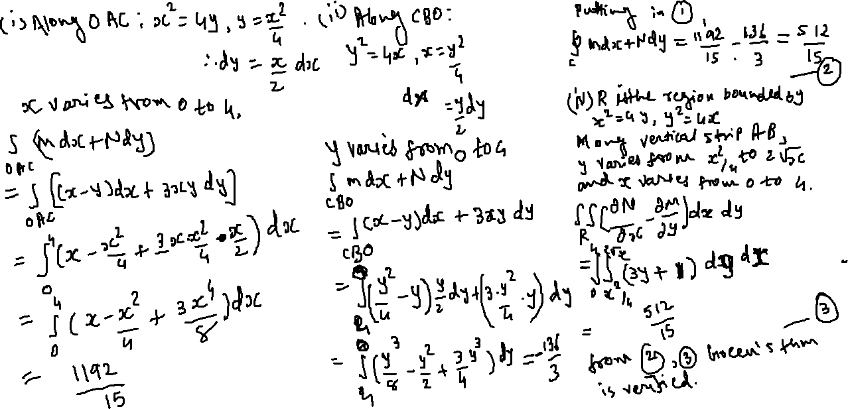
Green’s theorem

Slide 16
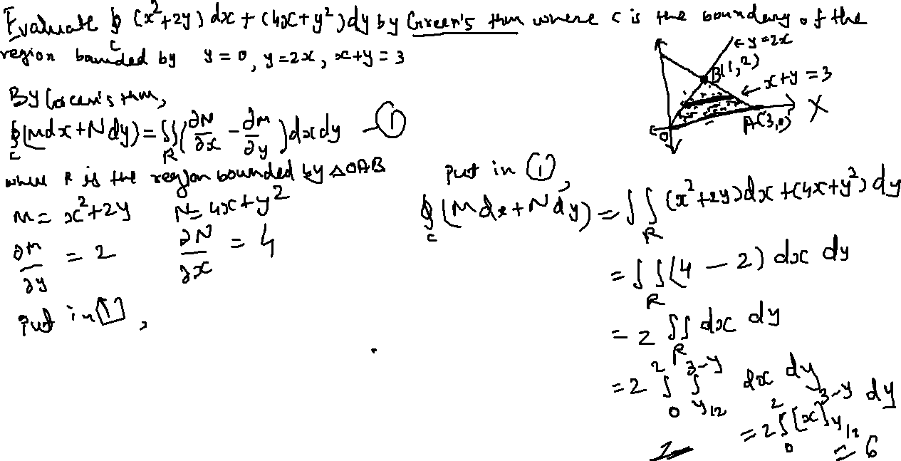
Green’s theorem

Slide 17
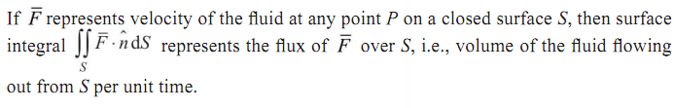
Surface Integration
Flux

Slide 18
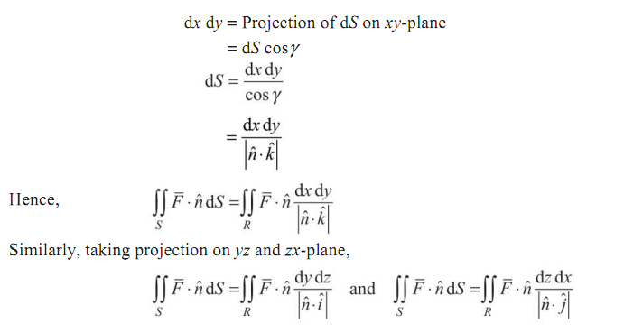
Surface Integration

Slide 19

Surface Integration

Slide 20


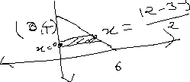
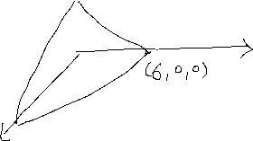









Surface Integration

Slide 21







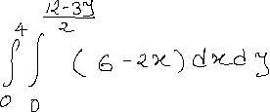

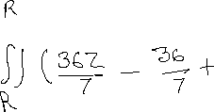


Surface Integration

